Slide 1


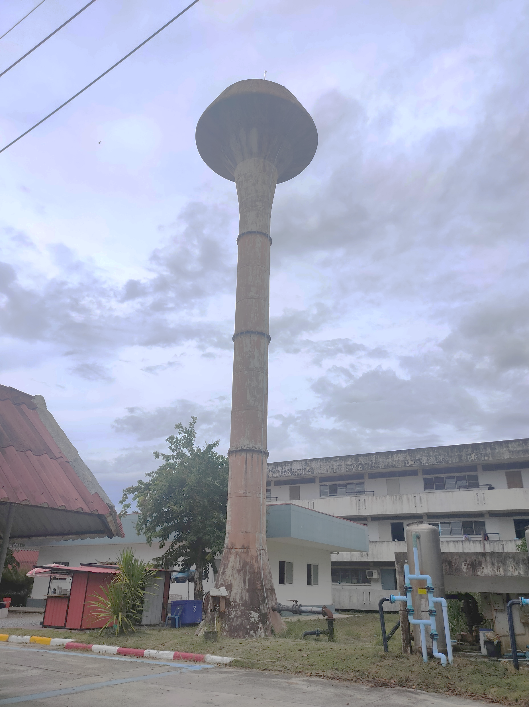
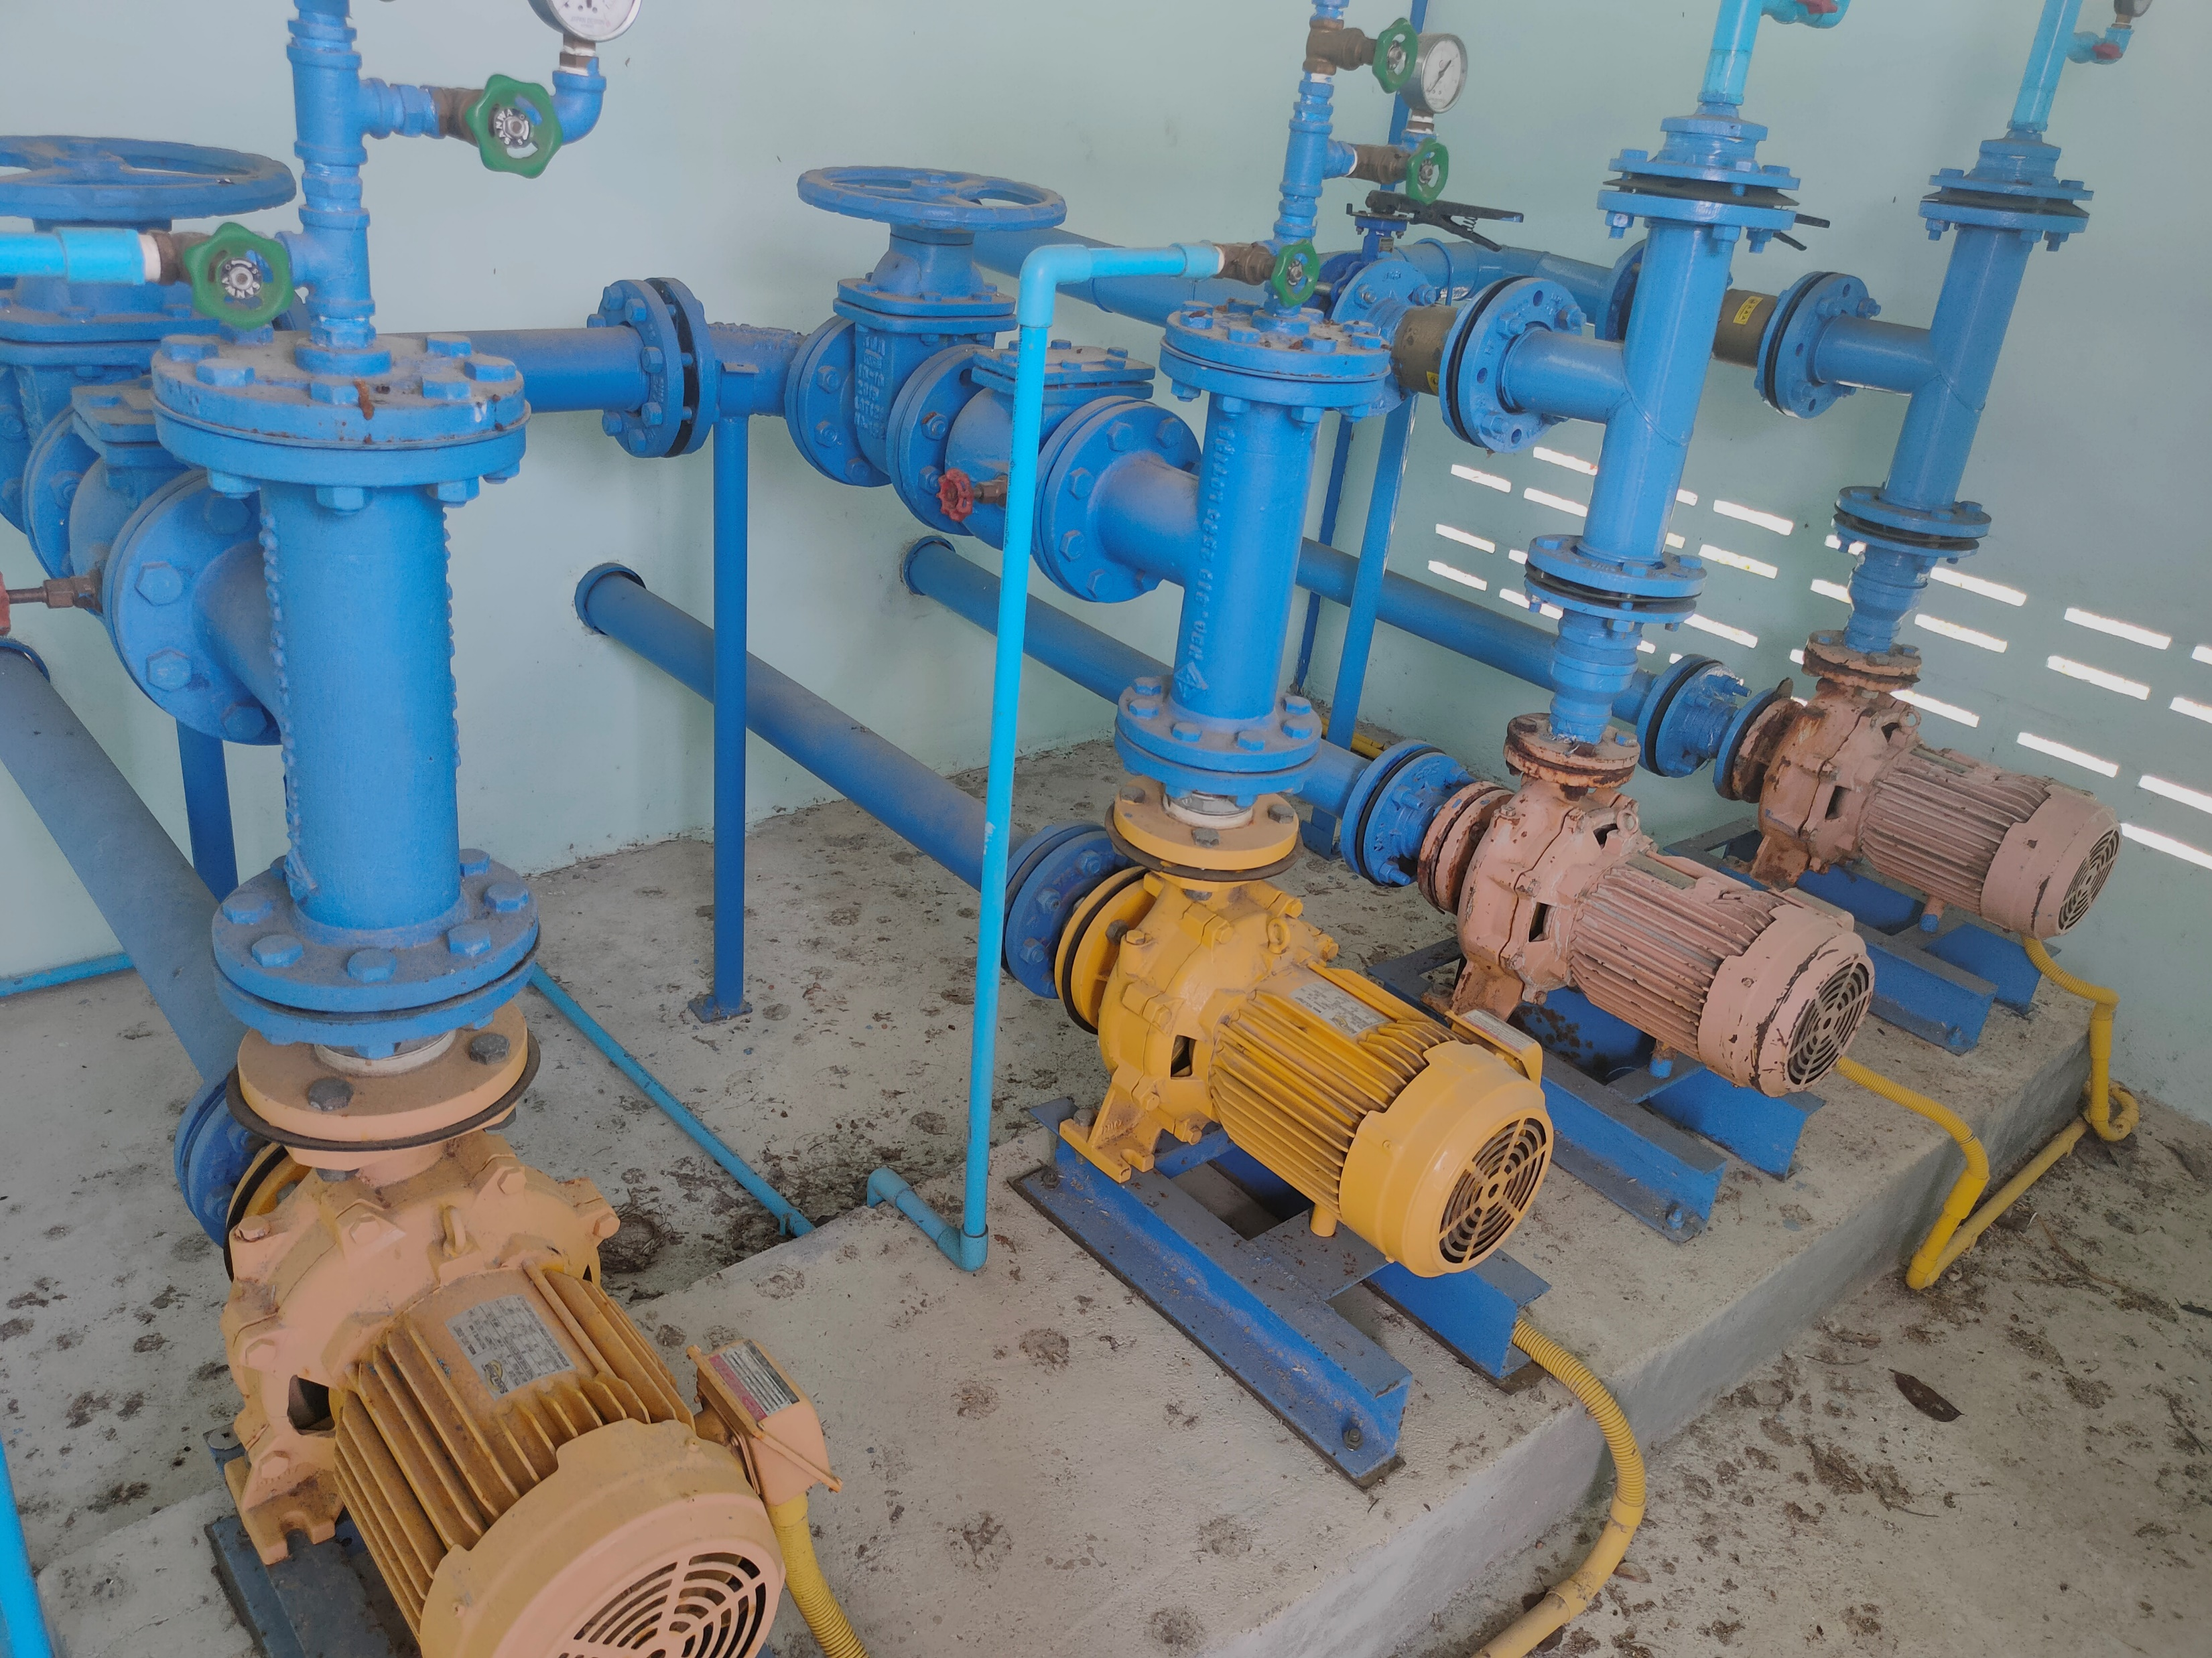
A notification and shutdown system for water pumps using
Internet of Things (IoT) technology.
Notes:
A notification and shutdown system for water pumps using Internet of Things (IoT) technology.

Slide 2

Background and Significance
Water pumps are important for homes and farms. But if they run without water (Dry Run), they can break and waste electricity. This project helps stop the pump when needed and alerts users to prevent damage.
Notes:
Water pumps are essential devices used in various sectors, including households, agriculture, and industry. It is undeniable that water pumps play a crucial role, and if a problem arises, it can cause significant disruptions.
One of the most common issues is operating under a "Dry Run" condition, where the pump runs without water flow. This situation leads to pump damage and unnecessary electricity consumption.
This project aims to develop a notification and shutdown system for water pumps using IoT (Internet of Things) technology. The system is designed to prevent damage and reduce maintenance costs by automatically detecting abnormal conditions and stopping the pump's operation when necessary.

Slide 3
Objectives
To develop a notification system that detects and prevents abnormal water pump operations.
To protect water pumps from damage.
To collect various operational data of the water pump.
Scope of Study
The pump must be at least 1 HP
The water pipe must be at least 1 inch
The system uses PZEM-004T, a device that measures electricity usage.
How the system detects problems
Dry Run: The pump is working, but no water is coming out. This may happen if something is blocking the water pipe.
High Electricity Use: If the pump needs too much power, it may be because the motor is stuck and harder to turn.
Notes:
Objectives
To develop a notification and protection system for detecting abnormal operations in water pumps.
To prevent water pump damage and extend its lifespan.
To collect operational data from the water pump for analysis and optimization.
Scope of Study
The water pump used must have a power rating of at least 1 horsepower to generate sufficient pressure for the Flow Switch to function properly.
The water outlet pipe must be at least 1 inch in diameter to accommodate the installation of a Flow Switch.
The system can measure electrical power consumption using the PZEM-004T module, which is designed for current measurement.
The detection of abnormal pump operation is based on two key factors:
Dry Run Condition: This occurs when the pump is operating but no water is flowing, potentially due to blockage in the suction pipe, preventing water intake.
Excessive Power Consumption: This may be caused by increased friction in the motor shaft, requiring more force to rotate and leading to higher electricity usage.

Slide 4
Prevents pump damage
The system automatically stops the pump when Dry Run or abnormal power usage is detected.
Reduces maintenance costs
Expected Benefits
Lowers repair costs and reduces the need to replace parts.
Can be used in many sectors
Can be used in households, agriculture, and industries.
Notes:
Expected Benefits
Prevention of Water Pump Damage – The system can automatically shut down the pump when it detects a Dry Run condition or abnormal power consumption, thereby extending the pump's lifespan.
Reduction of Maintenance Costs – By minimizing damage to the pump and related equipment, the system helps lower repair and maintenance expenses.
Versatile Application – The system can be implemented in households, agriculture, and industrial sectors, enhancing safety and operational efficiency for water pumps.

Slide 5
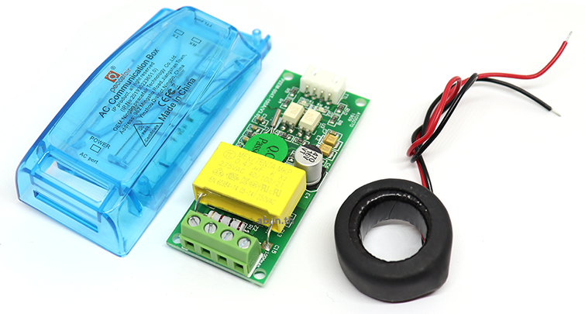
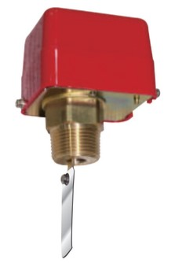
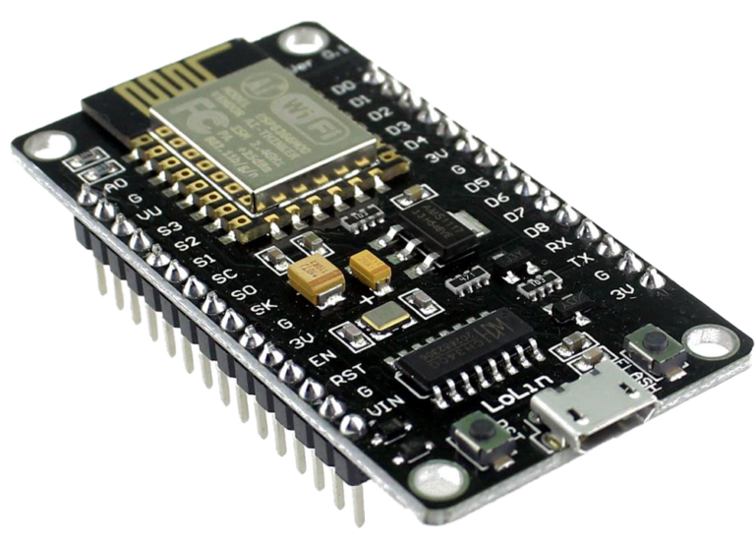
Implementation Steps
Study and Prepare Equipment
Learn how to use and test the Flow Switch, PZEM-004T, and NodeMCU ESP8266.
PZEM-004T
System Design
Design the system to meet the project goals, including both frontend and backend components.
System Performance Evaluation
Test the notification system,Test the automatic shutdown of the pump,Test settings and control via the interface.
Node MCU ESP8266
Flow Switch
Notes:
Implementation Steps
Study and Test the Equipment
Conduct a thorough functionality test of key components such as the Flow Switch, PZEM-004T, and NodeMCU ESP8266.
Ensure each component operates correctly and performs its intended function.
System Design & Deployment
Develop the system architecture, covering both frontend and backend operations to align with project objectives.
Implement core functionalities:
The Flow Switch determines whether water is flowing.
The PZEM-004T measures real-time power consumption and enables automatic shutdown via a relay module when abnormal conditions are detected.
Once the design is finalized, install the system components inside a protective plastic enclosure for real-world deployment.
System Performance Evaluation
Assess the effectiveness of the system based on three key tests:
Notification Test – Verify real-time alerts for abnormal pump operation.
Automatic Shutdown Test – Ensure the system correctly cuts off the pump when Dry Run or excessive power consumption is detected.
Interface Control Test – Evaluate system responsiveness through remote configuration and control via the user interface.

Slide 6
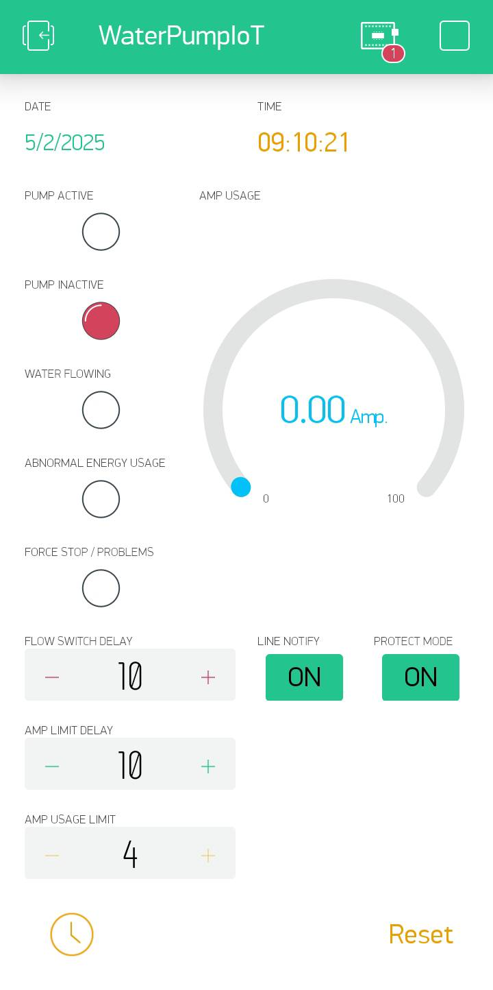
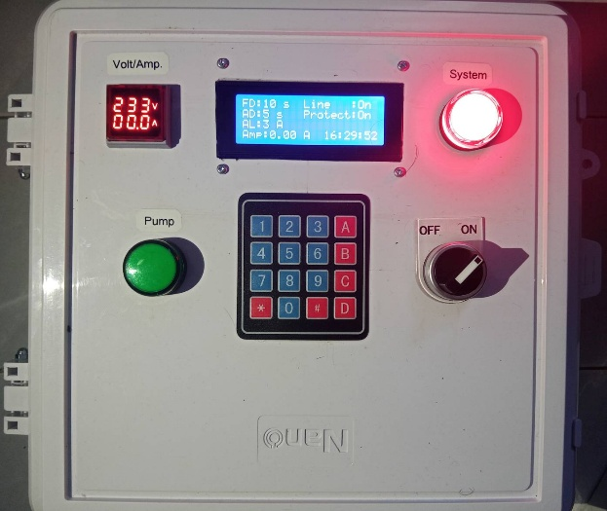
Results of Implementation
Hardware Design
The system uses the ESP8266 board as the main processor. It connects to input devices such as the Flow Switch, PZEM-004T, and 4x4 Keypad. The output device is an LCD 20x4 display.
Front View of the Device
Interface in Blynk
Notes:
Results of Implementation
The results are divided into two main sections:
1. Hardware Design
The ESP8266 board is used as the central processing unit, with the following input components:
Flow Switch – Detects whether water is flowing.
PZEM-004T – Measures the electrical power consumption of the pump.
Keypad 4x4 – Allows users to configure system settings.
The system also includes an LCD display as the output interface, providing real-time status updates to users.

Slide 7
Results of Implementation
Software Design
The system uses Blynk to display the control interface for the alert and shutdown system. This interface shows the pump status, system status, time, power consumption, and settings.
Interface in Blynk
ภาพด้านหน้าของอุปกรณ์
Notes:
2. Software Design
The Blynk application is used as the control interface for the system. This interface displays critical information such as:
Pump status
System status
Current time
Power consumption
User-defined settings, including shutdown delay and power limit thresholds
The Blynk interface consists of the following key components:
Five LED indicators – Display various system statuses.
Gauge meter – Shows real-time power consumption (in Amps).
Three input fields – Allow users to set parameters:
Shutdown delay when no water flow is detected
Shutdown delay when power consumption exceeds the limit
Maximum allowable power consumption threshold
Boolean settings (ON/OFF options):
Line Notify – Enables or disables notifications via LINE.
Protect Mode – If disabled, the system will not shut down the pump, even when issues are detected.

Slide 8
ระบบแจ้งเตือนและตัดการทำงานของปั๊มน้ำโดยใช้เทคโนโลยีอินเทอร์เน็ตในทุกสิ่ง
Experimental Results and Conclusion
The system accurately detects and notifies the pump status via LINE Notify and automatically shuts down in case of Dry Run or excessive power usage.
Testing showed that the system operates stably, reduces pump damage, lowers maintenance costs, and improves water management efficiency.
However, the Flow Switch may be inaccurate in some cases, and an unstable internet connection may cause notification delays, which can be improved in the future.
A notification and shutdown system for water pumps using
Internet of Things (IoT) technology.
คณะผู้จัดทำ
นายธรรมนิตย์ หนูยิ้มซ้าย
นายชยุต สรรพขาว
อาจารย์ที่ปรึกษา
นายฐปนวัฒน์ ชูกลิ่น
Notes:
Experimental Results and Conclusion
The system functioned as designed, successfully detecting Dry Run conditions and abnormal power consumption with high efficiency.
When a problem was detected, the system effectively sent alerts via LINE Notify and automatically shut down the pump, reducing the risk of damage.
This mechanism helps lower maintenance costs and prevents unnecessary energy consumption.
Users could easily configure the shutdown delay and power limits via the Blynk application, making the system user-friendly.
Challenges and Areas for Improvement
Despite its success, a few minor issues were observed:
Flow Switch Accuracy – In some cases, its precision could be improved.
Internet Stability – Delays in notifications were observed due to network instability.
Future Enhancements
To address these challenges, potential improvements include:
Using an ultrasonic Flow Sensor for more accurate water flow detection.
Developing an offline data logging system to store information when there is no internet connection.

Slide 9
A notification and shutdown system for water pumps using
Internet of Things (IoT) technology.
Thank you for
Your Attention
Project Team
Mr. Thammanit Nuyimsai
Mr. Chayut Sappakhao
Project Advisor
Mr. Thapanawat Chuklin
Notes:
This concludes our presentation. If the committee has any questions or concerns, we are happy to listen and provide answers.

